Slide 1
Penetration Resolution in Computer Modeled Fabrics
Collin Blake
Dr. John Whitcomb

Slide 2
Outline
Background
Textile Simulation
Data Types
Problem
ideas
Solution 1
Solution 2
SISL Library
Solution 3
Separating Axis Theorem
Issues
Current Work
Future Plans

Slide 3
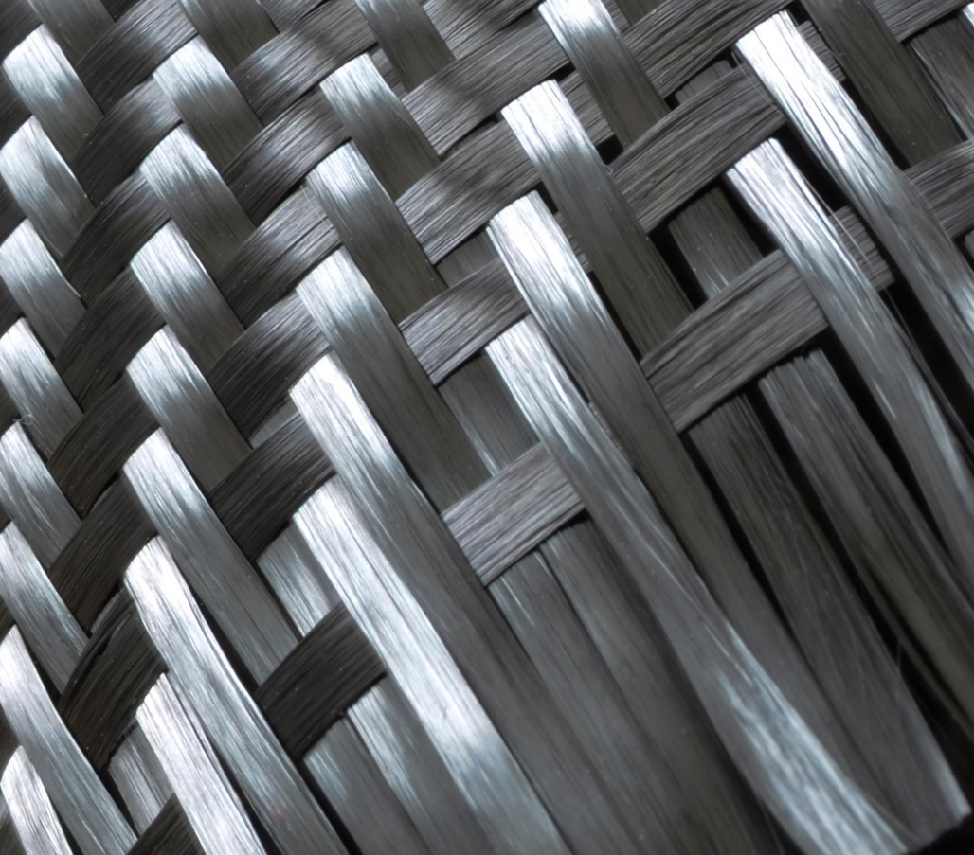
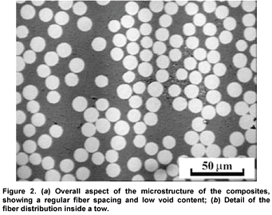
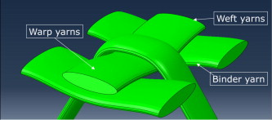
Background
Evolution of composite materials lead into computational analysis and design of fiber-reinforced structures
Current focus of these materials is understanding and simulating damage initiation and propagation
Extensive research at microstructure level
Mesoscale next level

Slide 4
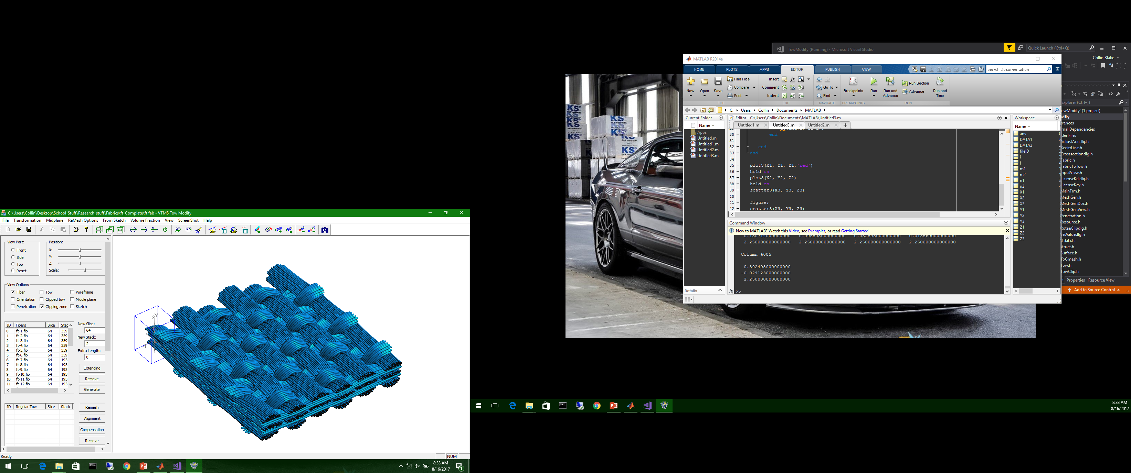
Background
Evolving modelling techniques and computational ability allow us to model increasingly complex geometries for computer analysis
Modelling discrete fibers very computationally expensive
Using Homogenized Tows with matrix surrounding tows

Slide 5
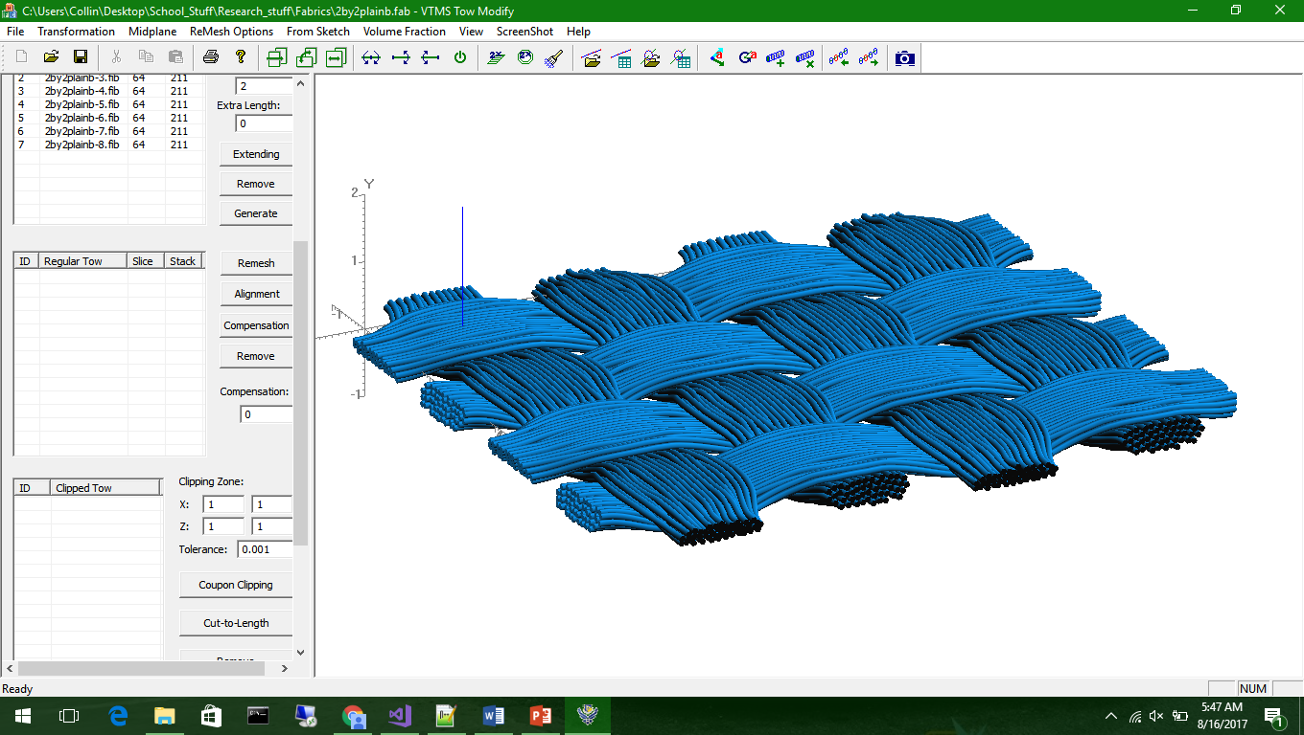
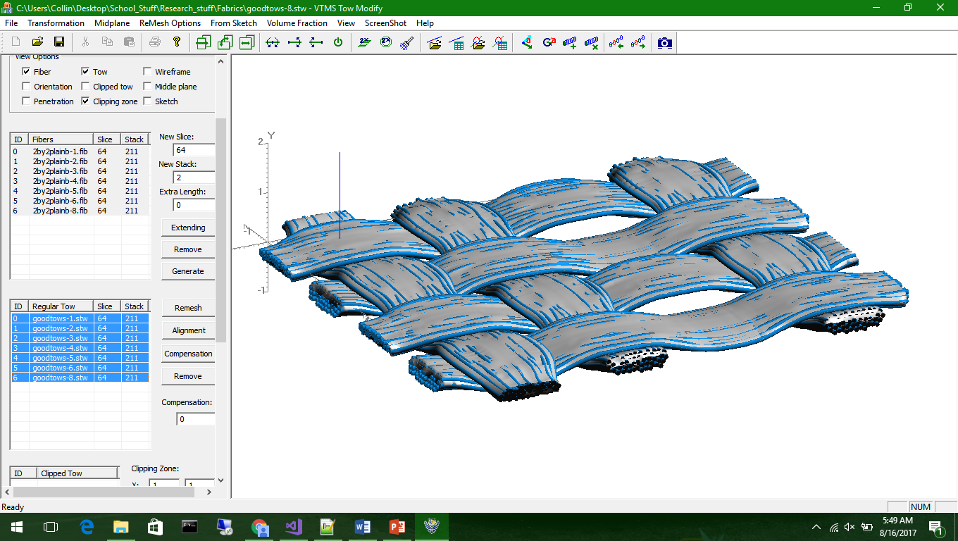
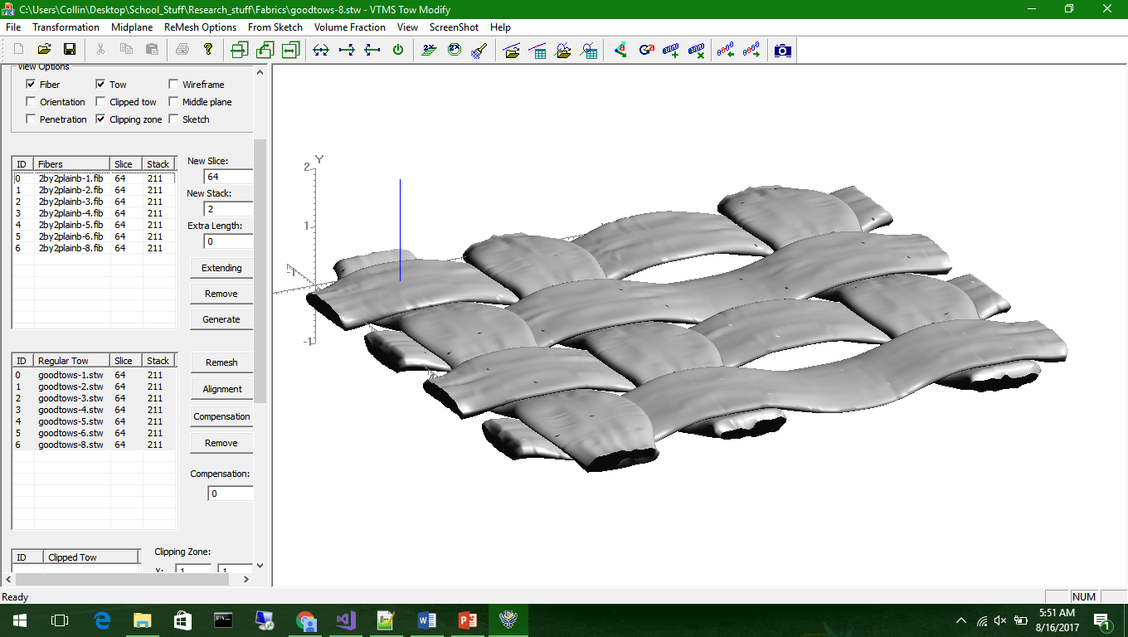
Textile Simulation
Using VTMS
Digital chain method to generate realistic woven geometry
Discrete fiber filaments can then be converted into homogenized tows and modelled in a matrix
Creates realistic woven geometries that can be analyzed

Slide 6
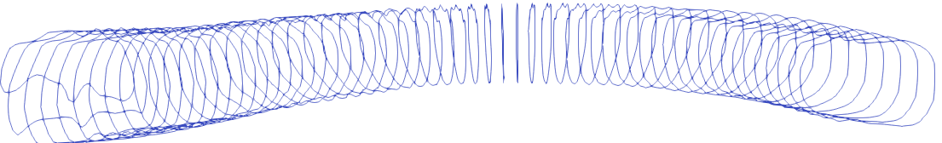
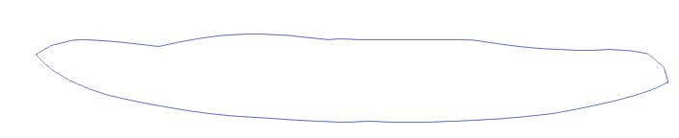
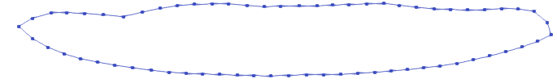
Data Types of VTMS
Standard Tow Format
Stacks that describe tow cross-section along tow path, defined by nodes
Internally, node location and outward normal stored, along with stack ownership
Exported data described by stack, with each node belonging to said stack

Slide 7
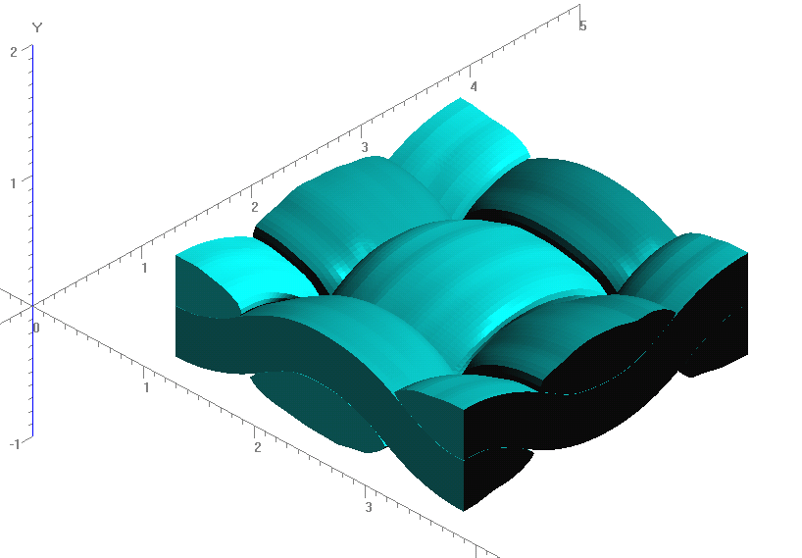
Data Types of VTMS (cont’d)
Clipped Tow Format
More traditional surface mesh style with surface elements and nodes
Internally stored is node location, element connectivity, and element outward normal
Exported data translates this data well
Currently do not have visualization tool implemented

Slide 8
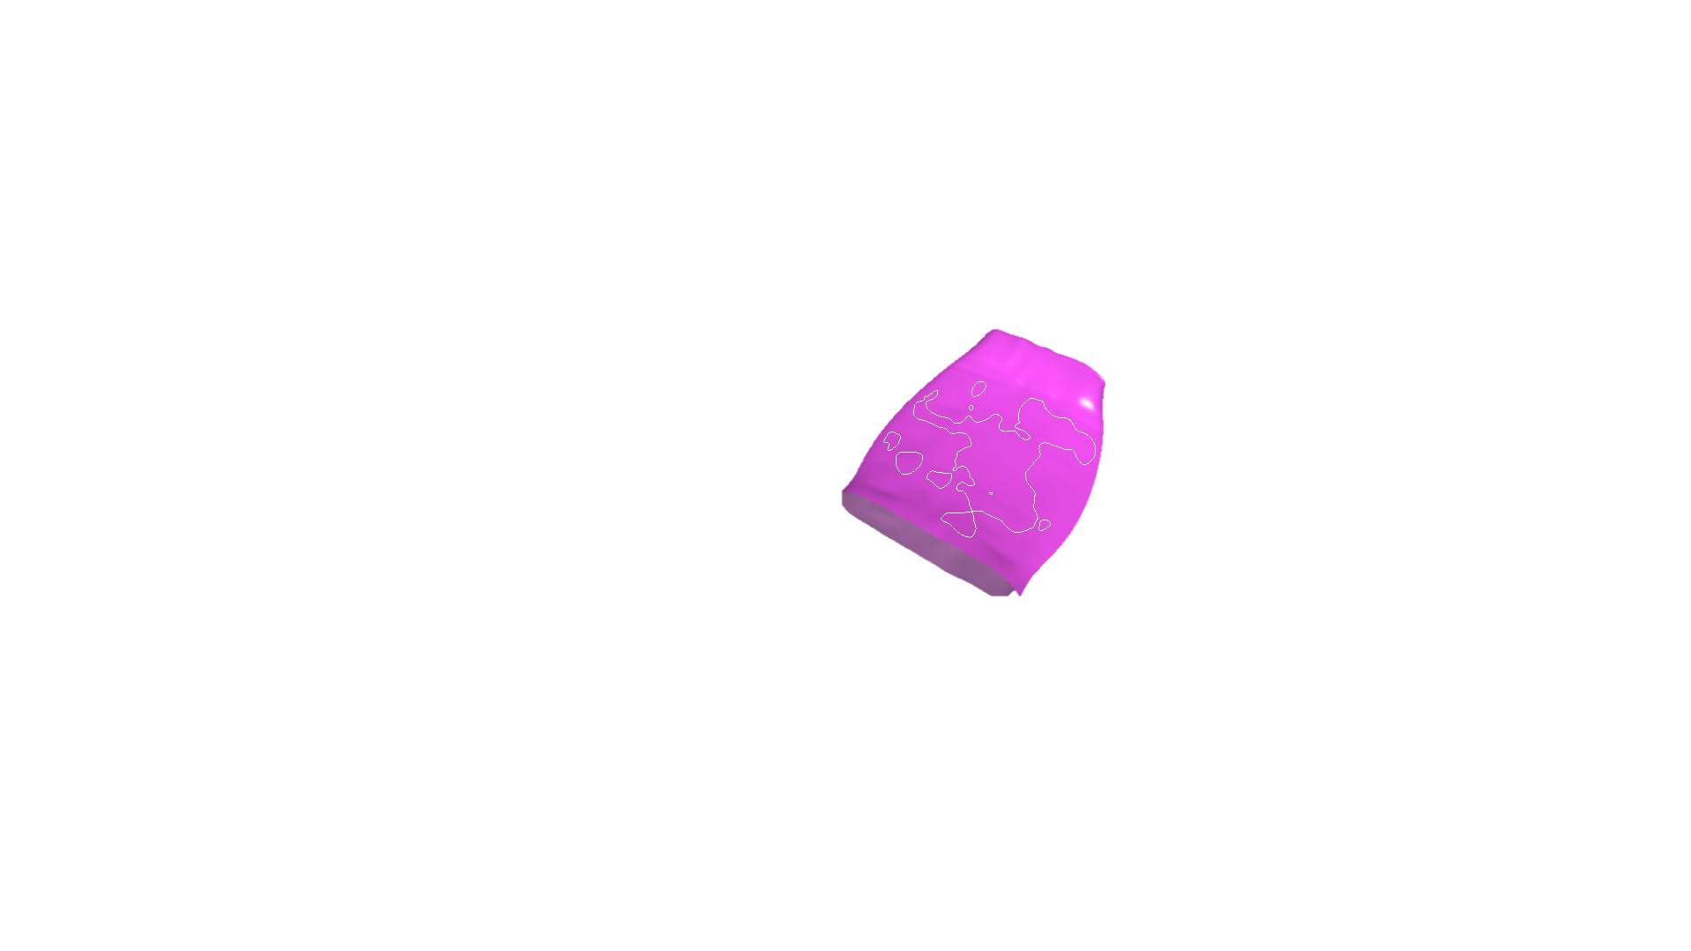
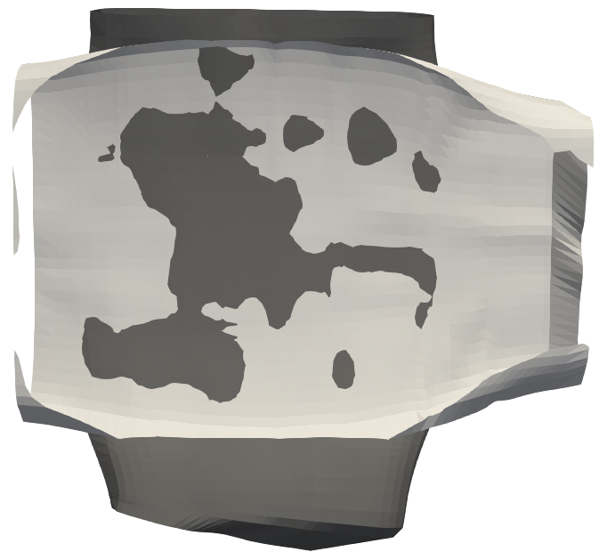
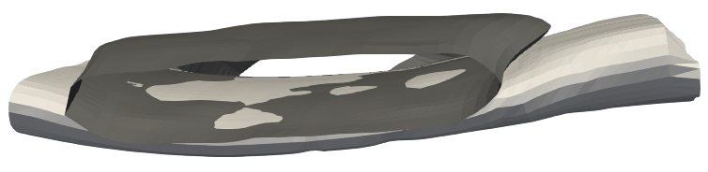
Penetration
Created geometries come with penetrating surfaces
Tows in close proximity develop surface penetrations after tow surface creation
Detecting Penetrations main problem
Conventional FEA programs cannot run analysis

Slide 9
Ideas
Polyhedron Penetration Detection
Used in video game physics
Difficult to determine penetration distance
Used primarily as avoidance, not resolution (time dependent)
Involves bounding box or Separating Axis theorem
Can also use node to surface distance and orientation algorithms to determine penetrating surface nodes
Use NURBS Surface to define penetrating surfaces
Gives analytical solution
More accurate for allowing intersection curves vs. penetrating nodes
Defines Penetration surface boundary
Reduces tow volumes during fitting
Can be difficult to redefine tow mesh along boundary

Slide 10
Initial Solution
In order to impose surface to surface contact, a plane is placed between the penetrating surfaces.
The penetrating nodes are then moved to this surface
This will ideally create a perfect contact surface between the tows

Slide 11
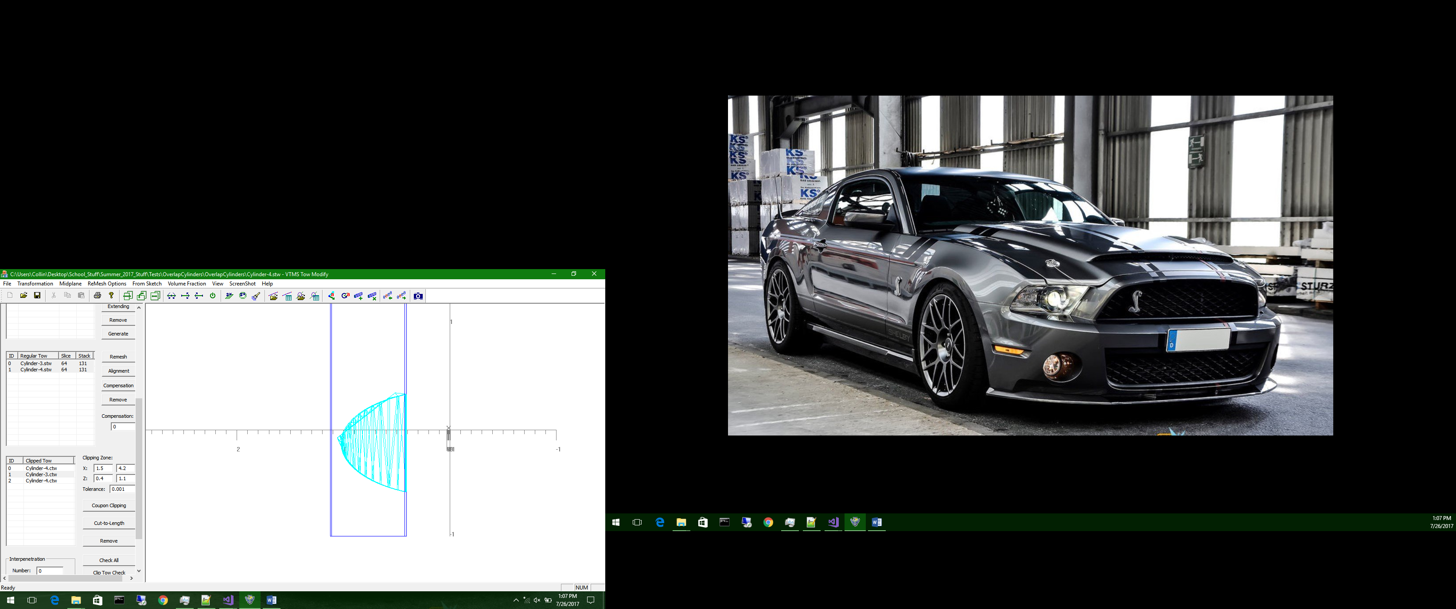
Issues Encountered
Creates “Spurs” near penetration boundary
Does not account for large curvatures
Can create too large of surface, significantly altering tow topography
Matrix pockets can also occur

Slide 12
Solution 2
Find nearest neighbor of penetrating node on tow being penetrated
Compute half distance and move both nodes to location
Resolves compatibility

Slide 13
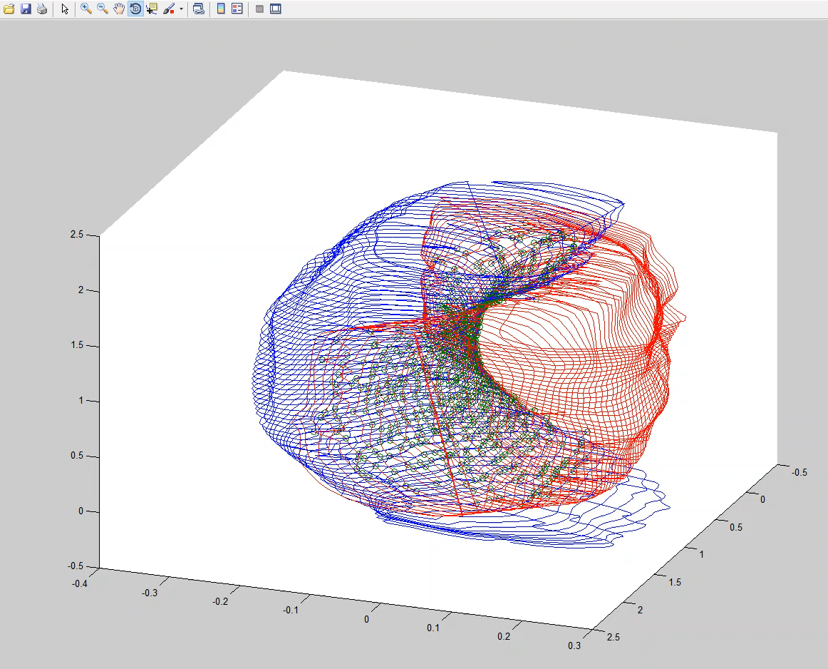
Solution 2 (cont’d)

Slide 14
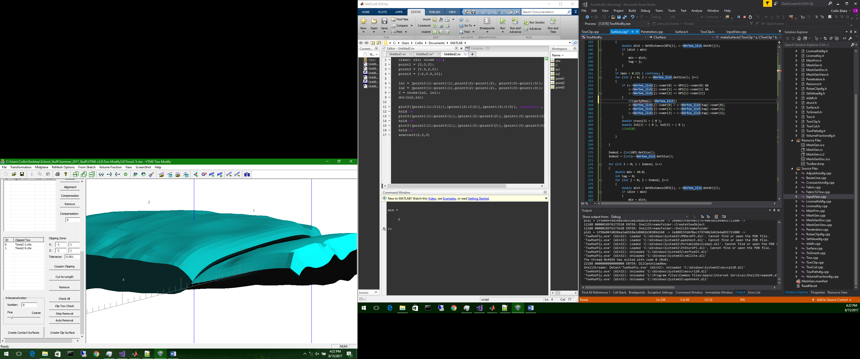
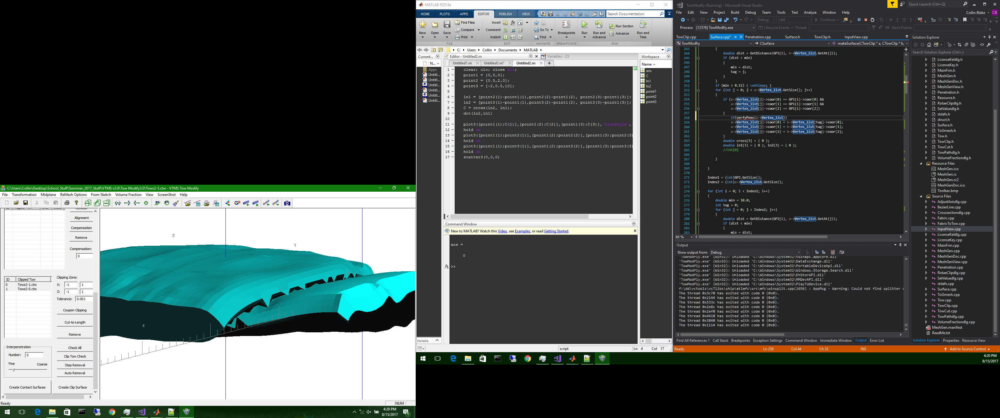
Solution 2 (Cont’d)
Known Issues
Degenerate Elements
Nodes allowed to move outside tow boundary
Jagged topography between tows
Possible Solutions
Mesh cleaning to renumber elements and nodes
Improve penetration routines
Correct with smoothening

Slide 15
SISL Library
Non-Uniform Rational B-Splines software library that gives user multiple algorithms for defining, using, and performing operations on surfaces
Interested in ability to describe discrete surfaces as analytic description and evaluate intersection between two surfaces
We would use this intersection data to create a solution to resolve penetration boundaries

Slide 16
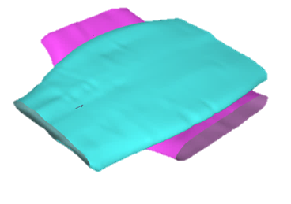
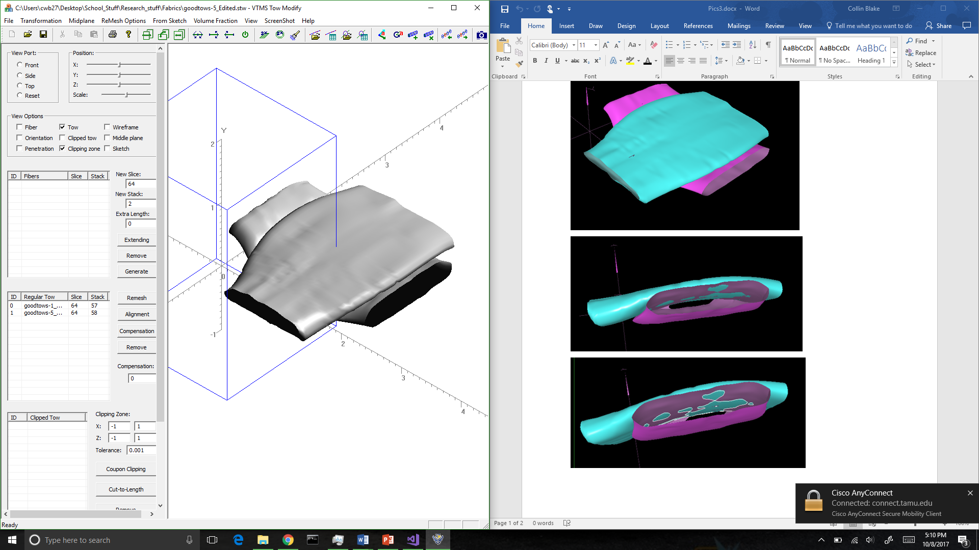

Solution 3
Create NURBS representation of tow surface using SISL library and .stw format (exported standard tow)
Continue to use library to detect interpenetration regions in the form of curves that encase the penetrations
Use these curves to correct the interpenetrations
Once the curves are found, the surfaces are translated back to a discrete surface mesh by sampling the NURBS surface and creating triangular elements

Slide 17
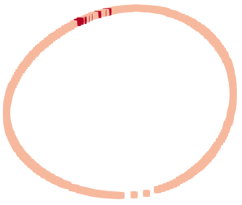
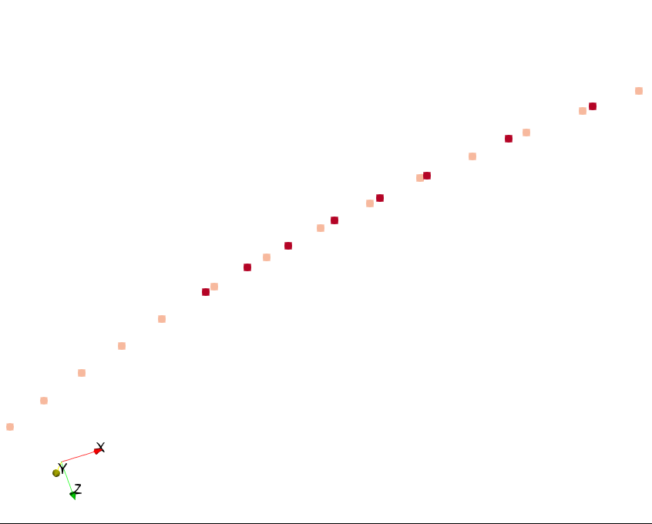
Solution 3 (Cont’d)
Once we have boundary curves, we translate the boundary curve into linear piecewise elements
We can use these piecewise curves to then verify that the curves are unique and do not overlap
An algorithm does this by determining if the endpoints of an curves lie on another
If this is the case we combine the curve unless they are duplicates, in which case we throw one away

Slide 18
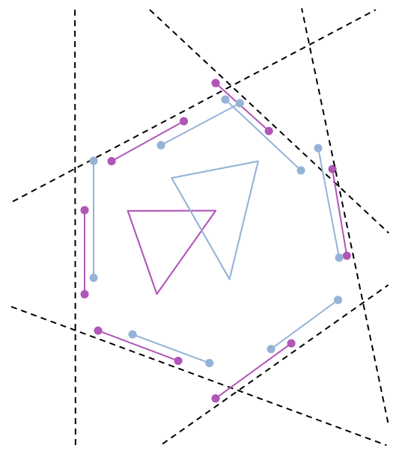
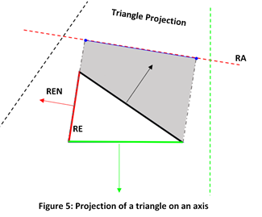
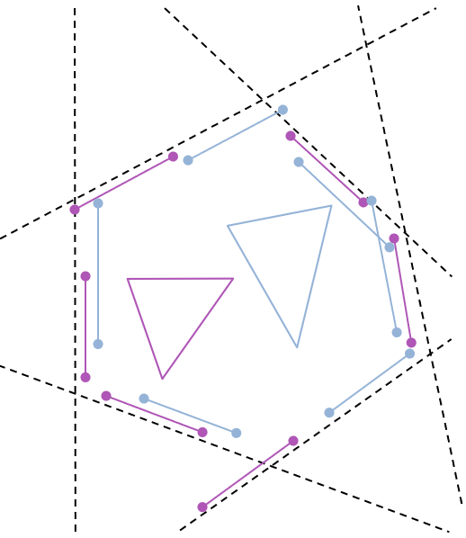
Separating Axis Theorem
The Separating Axis Theorem (SAT) is used to identify if two shapes (or line segment) intersect
It starts by selecting axes to project the limits of the shapes onto
Usually the chosen axes are those that are perpendicular to the edge of shape
Then the projections are tested to verify if they overlap
Overlap means they intersect
There only needs to be one axis on which the projections do not overlap to say that the shapes do not intersect

Slide 19
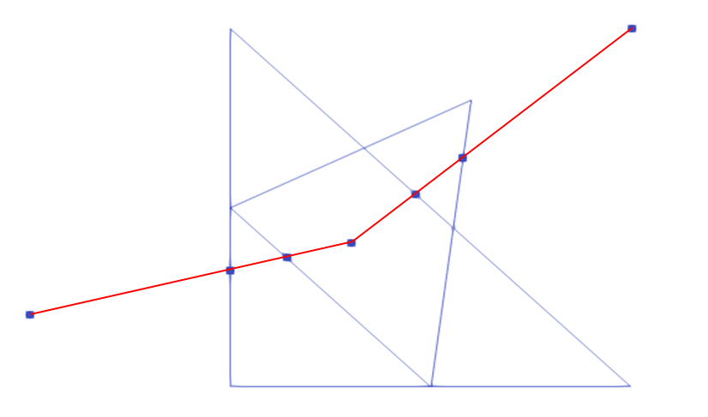
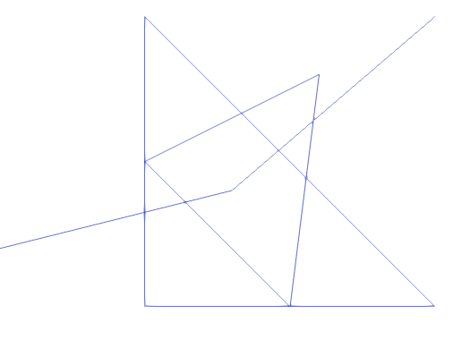
Solution 3 (CONT’d)
Using the unique curves, we loop over each curve segment and use a KDTree to find the nearest surface elements to the segment for both tows
Then for each element we check that the segment intersects or not using the Separating Axis Theorem
If the segment intersects the element, we store the element and then check if an element edge is intersected by the segment
If so, the segment is divided by a point that identifies where the edge and segment cross

Slide 20
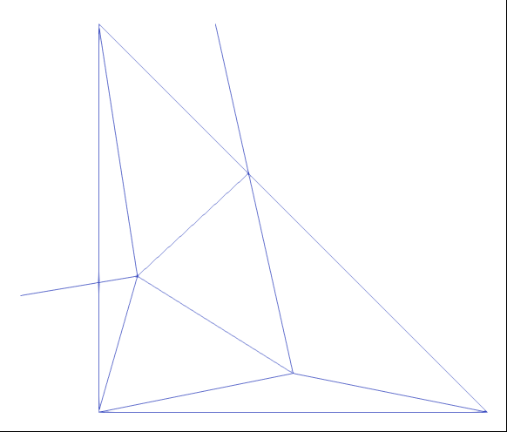
Solution 3 (Cont’d)
Once all elements of both tows have been looped over, we return the intersected elements and the refined intersection boundary curve
Then we loop over the intersected elements and for each element we determine if a segment has a node in or lies on the edge of an element
We collect the nodes and through an algorithm
Then sub-mesh the element using the boundary segment points and intersection points

Slide 21
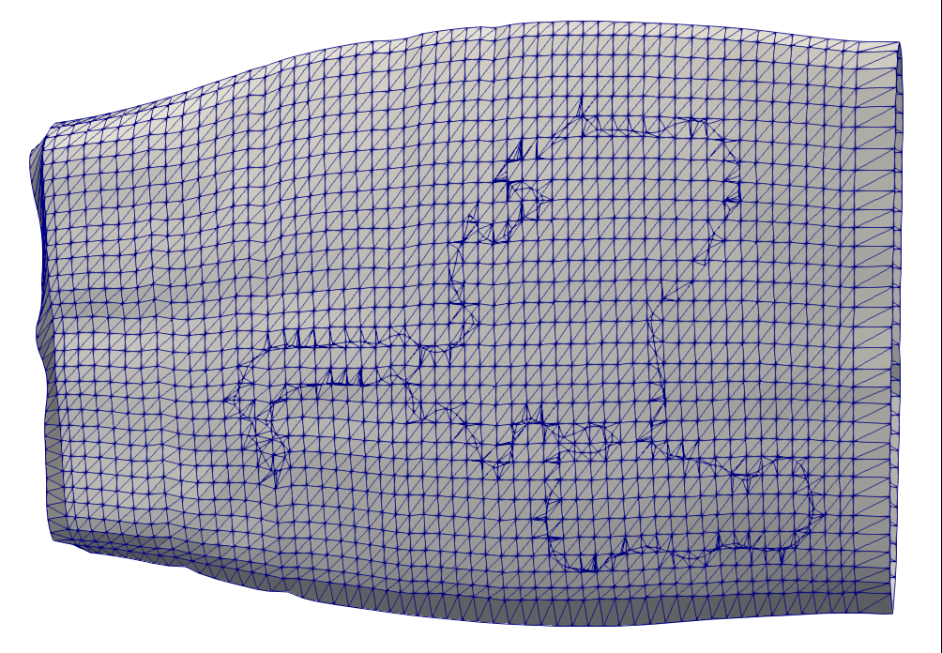
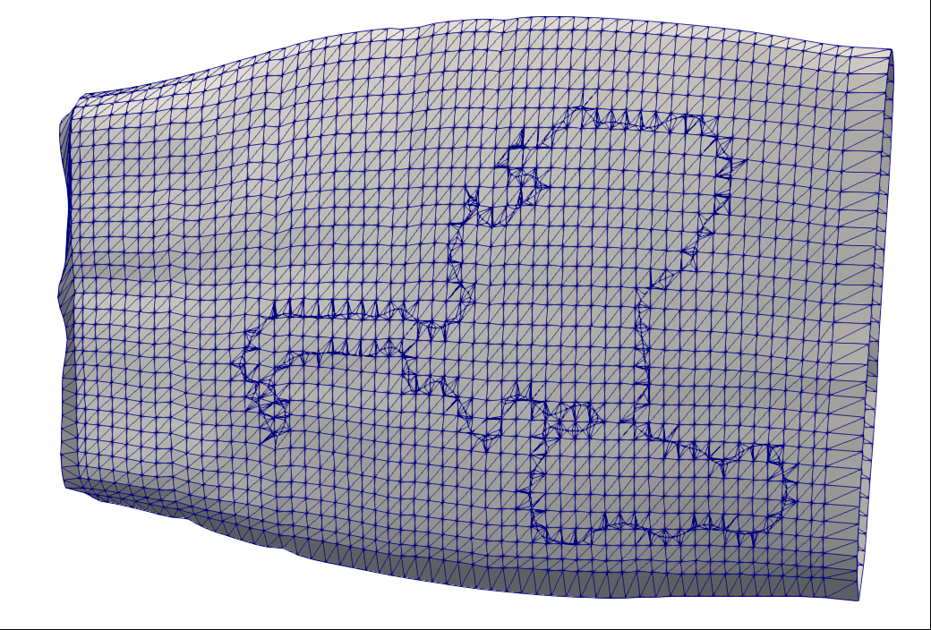
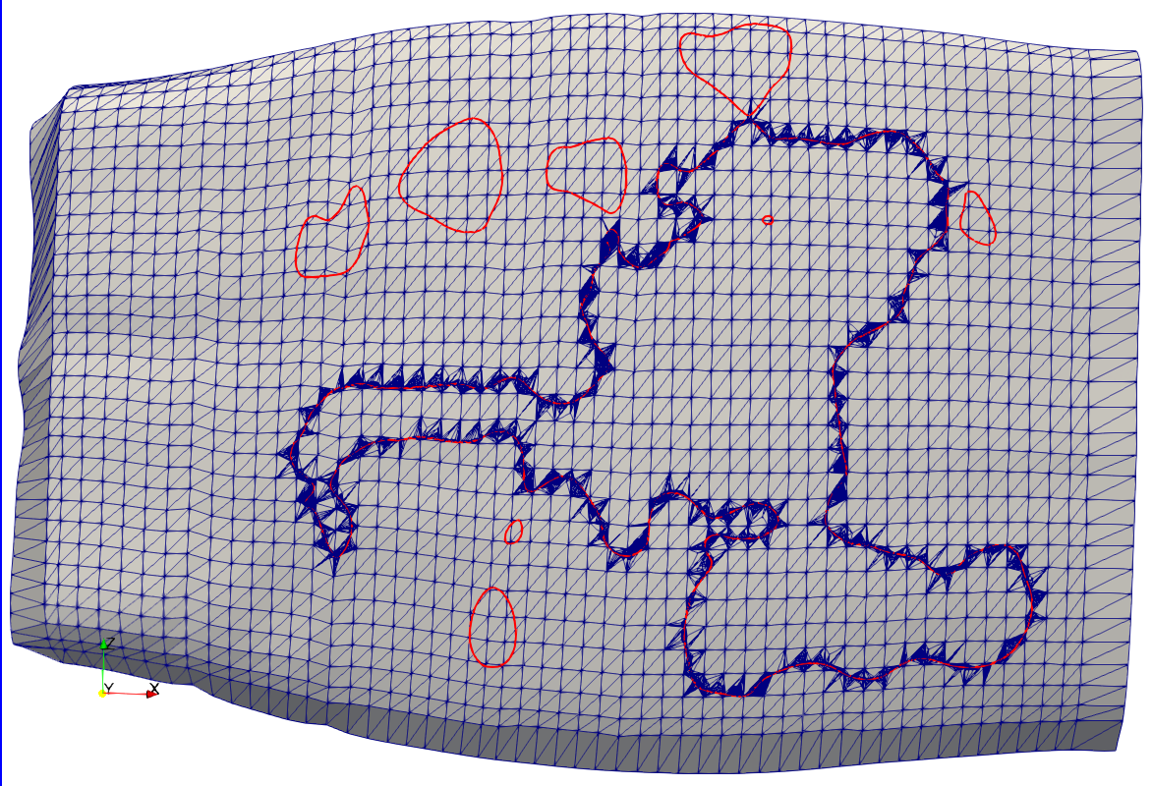
Solution 3 (Cont’D)
Once every intersected element is sub-meshed, we add the new sub-meshes back to the surface mesh
Have also attempted to reduce curve refinement by only keeping one node between intersection points
Or less
The result is surface tow meshes that are compatible along the boundary curves

Slide 22
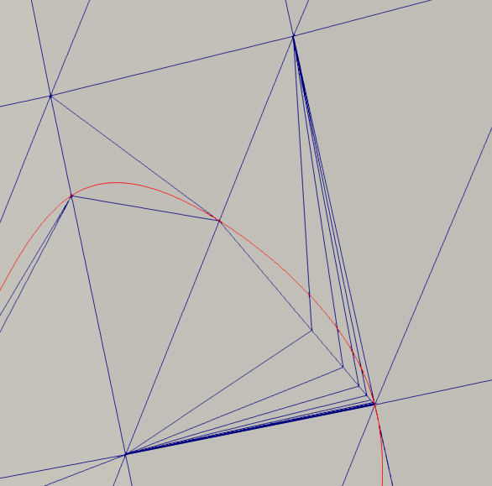
Issues
One of the biggest issues currently is the high aspect ratio elements and uneven, high refinement areas of sub-meshed elements
Occurs:
When boundary curve is close to element node
When two intersection points from different tows are close
Possible solutions:
Move element node to intersection point, effectively removing the penetration

Slide 23
Current Work
Solving issue of “bad” element refinement
As discussed, high-aspect elements cause numerical issues
Possible solutions still being explored
Collecting of elements contained by boundary curves after refinement
Analyzing implementation of current algorithms for determining outward normal of surface elements
Could significantly speed up collection algorithm

Slide 24
Future Work
Finish element gathering inside of boundary curve
Implement Boolean operation for adding/subtracting meshes between tow surfaces
Create output format for interpenetration elements and visualization tools
Discuss further improvements if time permits

Slide 25
Questions?

Slide 26
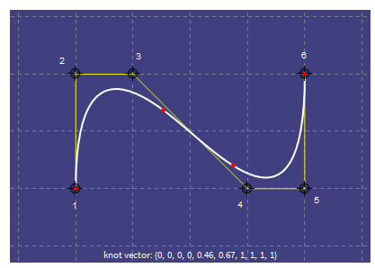
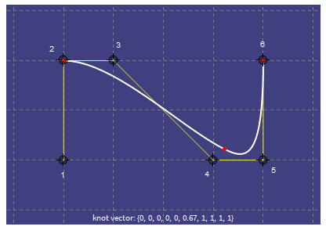
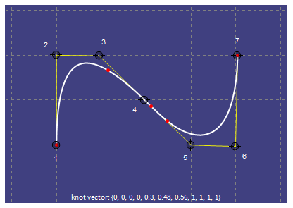
NURBS

Slide 27
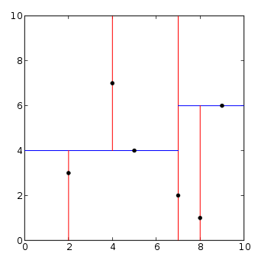
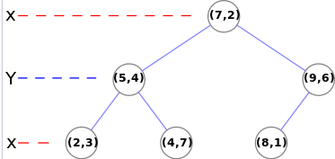
K-D Tree

